Slide 1
IBM Logo History
All images and text from the IBM Archives at
http://www-03.ibm.com/ibm/history/index.html

Slide 2
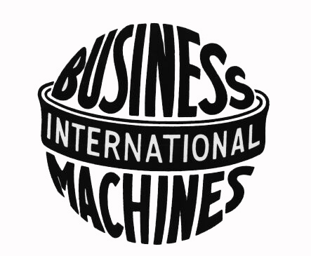
International Business Machines (1924-1946)
In 1924, the Computing-Tabulating-Recording Company adopted the name International Business Machines Corporation. The ornate, rococo letters that formed the "CTR" logo were replaced by the words "Business Machines" in more contemporary sans-sarif type, and in a form intended to suggest a globe, girdled by the word "International."

Slide 3
IBM in transition (1947-1956)
IBM borrowed on the equities in its brand image and reputation to help carry it through a difficult transition from the punched-card tabulating business to computers. It began with a change to the logotype, the first in 22 years. The new logo appeared on the masthead of the January 1, 1947 issue of Business Machines with surprisingly little fanfare. The familiar "globe" was replaced with the simple letters "IBM" in a typeface called Beton Bold.

Slide 4
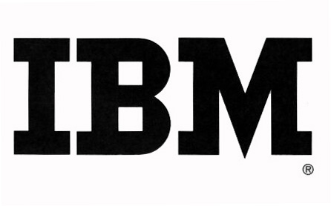
IBM continuity (1956-1972)
In May 1956, shortly before he died, Thomas J. Watson, Sr., presided over the official installation of his son as IBM's chief executive. Tom Watson, Jr. moved quickly, using both actions and symbols to signify a new era. The first visible expression was a relatively subtle change in the company's logotype — subtle, in part, to communicate that any changes would come within an overall continuity. Created by noted graphic designer Paul Rand, the new logotype replaced the former Beton Bold typography with City Medium, as the letters "IBM" took on a more solid, grounded and balanced appearance.

Slide 5
IBM international recognition (1972- )
In 1972, the company introduced a new version of the logotype. Designed by Paul Rand, horizontal stripes now replaced the solid letters to suggest "speed and dynamism." In the intervening quarter-century, the basic design has remained constant, one of the most recognized logotypes in the world, and a design that has been widely imitated by others.

